Slide 1

Infrared Absorption Spectroscopy (IR)

Slide 2
What is Infrared absorption spectroscopy?
IR absorption spectrum is based on transitions between vibrational energy levels.

Slide 3
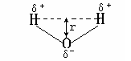
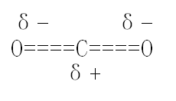
1. Mechanism
E_{IR}=ΔE_{vib} or ν_{IR}=ν_{vib}
Coupling between Infrared light and molecules：Molecular dipoles must be changed during vibration (Δμ≠0)，if not, no IR absorption will occur (eg. symmetrical stretching vibration of C≡C in R―C≡C―R, CO₂，r=0, μ=0, no IR signal).
Molecular Dipole (μ)
μ＝δr

Slide 4
Molecular Vibration
Stretching Vibration
Movement along the bond direction
Bond length change
Symmetry vibration（υ_{s}）and anti-symmetry vibration（ υ _{as} ）
Bending Vibration
Movement verticle to the bond direction
Bond angle change
In-plane bending vibration（δ）and out-plane bending vibration（ γ ）

Slide 5
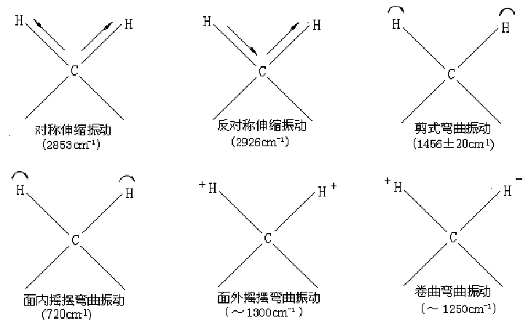
Vibration of methylene group

Slide 6
2) Infrared Spectrum
Infrared region: 0.76～1000 µm
0.76～2.5 µm near infrared region
2.5～25 µm mid infrared region
25～1000 µm far infrared region
Infrared Spectrum

Slide 7
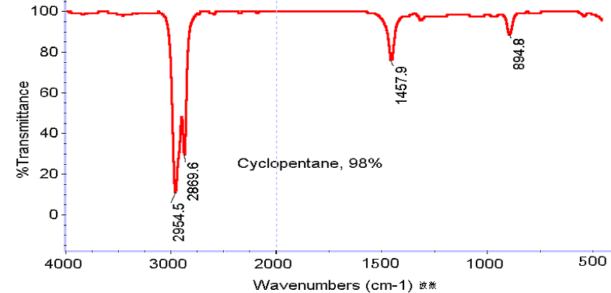
Y coordination：Transmittance（%）
X coordination：Wave number（cm⁻¹）。
Wave number: ν=1/λ

Slide 8
Selection Rules：
Maximum transition probability: variation of the vibrational quantum number (ΔV) = ± 1
Fundamental frequency: The absorption frequency for transition from the ground state (V = 0) to the first excited state of vibration (V = 1).

Slide 9
Infrared absorption spectrum band
Fundamental frequency: The absorption frequency for transition from the ground state (V = 0) to the first excited state of vibration (V = 1).
Multiple frequency: The absorption frequency for transition from the ground state (V = 0) to the higher excited state of vibration (V = 2,3,…).
Combined frequency: The absorption frequency for two different transitions.

Slide 10
Infrared absorption spectrum coupling
Vibration coupling: When two adjacent groups are with similar vibration frequencies, vibration coupling splitting would occur and produces two peaks, one moves to higher frequency and other to lower
Fermi coupling: The fundamental frequency couples with the multiple/combined frequencies and enhances the intensities of the latter.

Slide 11
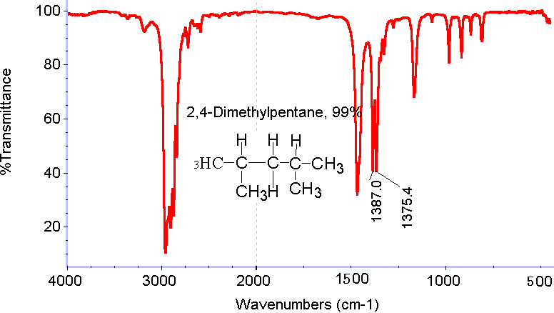
Vibration coupling：
2,4-dimethylpentane
The symmetrical bending vibration frequency of CH₃ is 1380cm⁻¹. When two methyl groups are linked to the same C，vibration coupling is occurred and 1380cm⁻¹ disappeared. Meanwhile, two new peaks, 1385 cm⁻¹ (higher) and 1375 cm⁻¹ (lower) appear.

Slide 12
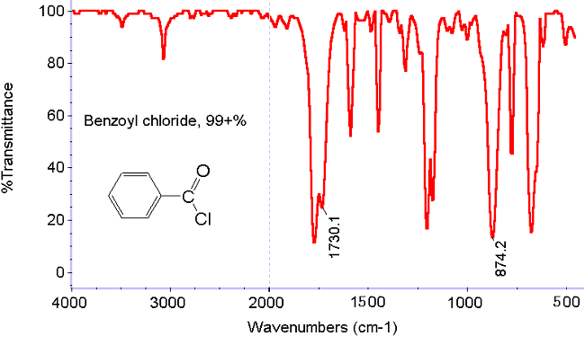
Fermi coupling:
Benzoyl chloride
The stretching vibration of C-Cl is at 874cm⁻¹，with a multiple frequency at around 1730cm⁻¹, which is near the stretching vibration of C=O. The fermi coupling occurs and enhances the intensity around 1730cm⁻¹.

